Slide 1
Topics to be covered :
UNIT-5. HASHING
Hashing : Basic concepts Hashing Methods : Division Method, Mid Square Method, Folding Method, Multiplication Method,
Collision Resolution Techniques: Separate chaining (open hashing), Open addressing (closed hashing): Linear Probing, Quadratic Probing.concepts,
Upon completion you will be able to
Explain Basic Hashing concepts.
Explain Hashing Methods and collision resolution techniques.

Slide 2
Topics to be Covered
1. What is hashing ?
2. Need for hashing
3. Key components for Hashing.
4. Hashing Methods or Types of Hash Functions
5. Basic Operation on Hashing
6. What is Collision?
7. Methods of resolving the collisions and with examples
8. Comparision of Collision Resolution Techniques
9. Comparison of collision resolution by Open Addressing stretegies
10. Advantages of Hashing in Data Structures

Slide 3
1. What is Hashing?
Hashing refers to the process of generating a fixed-size output from an input of variable size using the mathematical formulas known as hash functions.
This technique determines an index or location for the storage of an item in a data structure.
In otherwords hashing is a technique that involves converting a large amount of data into a fixed-size value or a smaller value called a Hash or hash address. The hash is generated through a hash function, which maps the input data to an output hash or hash address. The resulting hash value can then be used to efficiently to search, retrieve, and compare data within large data sets.

Slide 4
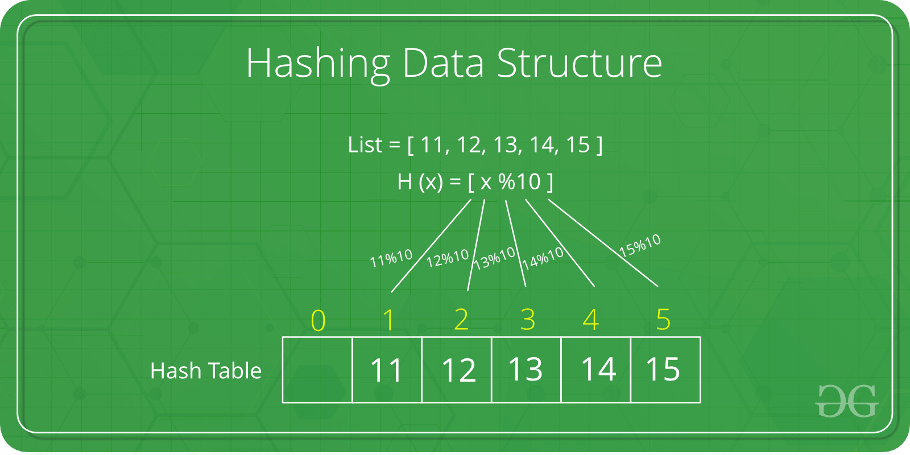
Examples on Hash Data Structure
Example-1

Slide 5
Example-2

Slide 6
2. Need for Hash data structure
The amount of data on the internet is growing exponentially every day, making it difficult to store it all effectively.
In day-to-day programming, this amount of data might not be that big, but still, it needs to be stored, accessed, and processed easily and efficiently.
A very common data structure that is used for such a purpose is the Array data structure.
Now the question arises if Array was already there, what was the need for a new data structure! The answer to this is in the word “efficiency“.
Though storing in Array takes O(1) time, searching in it takes at least O(log n) time.
This time appears to be small, but for a large data set, it can cause a lot of problems and this, in turn, makes the Array data structure inefficient.
So now we are looking for a data structure that can store the data and search in it in constant time, i.e. in O(1) time.
This is how Hashing data structure came into play.
With the introduction of the Hash data structure, it is now possible to easily store data in constant time and retrieve them in constant time as well.

Slide 7
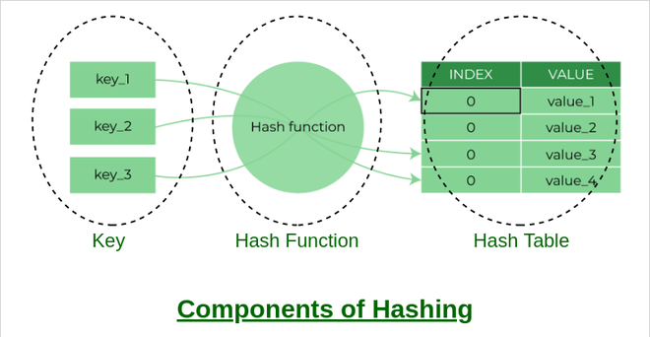
3. Components of Hashing
There are majorly three components of hashing:
Key: A Key can be anything string or integer which is fed as input in the hash function the technique that determines an index or location for storage of an item in a data structure.
Hash Function: The hash function receives the input key and returns the index of an element in an array called a hash table. The index is known as the hash index.
Hash Table: Hash table is a data structure that maps keys to values using a special function called a hash function. Hash stores the data in an associative manner in an array where each data value has its own unique index.

Slide 8
4. Hashing Methods or Types of Hash Functions
There are many hash functions that use numeric or alphanumeric keys. We will focus and discuss only the following 4 hash functions:
1. Division Method or Modulo Division method
2. Mid Square Method.
3. Folding Method or Digit folding Method
4. Multiplication Method.

Slide 9
4.1. Modulo Division Method:
it is best suited that M is a prime number as that can make sure the keys are more uniformly distributed. The hash function is dependent upon the remainder of a division.
Example:
k = 12345, M = 95
h(12345) = 12345 mod 95
= 90
k = 1276, M = 11
h(1276) = 1276 mod 11
= 0
This is the most simple and easiest method to generate a hash value. The hash function divides the value k by M and then uses the remainder obtained.
Formula:
h(K) = k mod M
Here,
k is the key value, and
M is the size of the hash table.

Slide 10
Pros: This method is quite good for any value of M.
The division method is very fast since it requires only a single
division operation.
Cons: This method leads to poor performance since consecutive
keys map to consecutive hash values in the hash table.
Sometimes extra care should be taken to choose the value of M

Slide 11
C-Code for Modulo Division Hashing Fuction
int hashing_moduloDivision(int key)
{
return key % TABLE_SIZE;
}

Slide 12
4.2 Mid Square Method:
Example: Suppose the hash table has 100 memory locations.
So r = 2 because two digits are required to map the key to the memory location.
k = 60
k x k = 60 x 60
= 3600
h(60) = 60
The hash value obtained is 60
.
The mid-square method is a very good hashing method. It involves two steps to compute the hash value-
1. Square the value of the key k i.e. k2
2. Extract the middle r digits as the hash value.
Formula: h(K) = h(k x k)
Here,
k is the key value.
The value of r can be decided based on the size of the table.

Slide 13
Pros:
The performance of this method is good as most or all digits of the key value contribute to the result. This is because all digits in the key contribute to generating the middle digits of the squared result.
The result is not dominated by the distribution of the top digit or bottom digit of the original key value.
Cons:
The size of the key is one of the limitations of this method, as the key is of big size then its square will double the number of digits.
Another disadvantage is that there will be collisions but we can try to reduce collisions.

Slide 14
C -Code for Mid Square Hashing Function Assumption : Table size =10 and r =1
int hashing_midsquare(int key)
{
int hashvalue;
//Need to take care of overflow in case of larger number
long int keysquare = key * key;
keysquare =keysquare/10;
hashvalue =keysquare % 10;
return hashvalue;
}

Slide 15
4.3. Folding Method or Digit folding Method
This method involves two steps:
Divide the key-value k into a number of parts i.e. k1, k2, k3,….,kn, where each part has the same number of digits except for the last part that can have lesser digits than the other parts.
Add the individual parts. The hash value is obtained by ignoring the last carry if any.
Formula: k = k1, k2, k3, k4, ….., kn
s = k1+ k2 + k3 + k4 +….+ kn
h(K) = s Here, s is obtained by adding the parts of the key k

Slide 16
Example:
k = 12345
k1 = 12, k2 = 34, k3 = 5
s = k1 + k2 + k3 = 12 + 34 + 5
= 51
h(K) = 51
Note: The number of digits in each part varies depending upon the size of the hash table. Suppose for example the size of the hash table is 100, then each part must have two digits except for the last part which can have a lesser number of digits.

Slide 17
C - Code for Constatnt Folding hashing Function
int hashing_folding(int key)
{
int hashvalue=0;
while(key!=0)
{
hashvalue+=key % 10;
key=key/10;
}
return hashvalue;
}

Slide 18
4.4. Multiplication Method
This method involves the following steps:
1. Choose a constant value A such that 0 < A < 1.
2. Multiply the key value with A.
3. Extract the fractional part of kA.
4. Multiply the result of the above step by the size of the hash table i.e. M.
The resulting hash value is obtained by taking the floor of the result obtained in step 4.
Formula: h(K) = floor (M X (kA mod 1))
Here,
M is the size of the hash table, k is the key value.
A is a constant value.

Slide 19
Example:
k = 12345
A = 0.357840
M = 100
h(12345) = floor[ 100 (12345*(0.357840 mod 1)]
= floor[ 100 (4417.5348 mod 1) ]
= floor[ 100 (0.5348) ]
= floor[ 53.48 ]
= 53

Slide 20
Pros: The advantage of the multiplication method is that it can work with any value between 0 and 1, although there are some values that tend to give better results than the rest.
Cons: The multiplication method is generally suitable when the table size is the power of two, then the whole process of computing the index by the key using multiplication hashing is very fast.

Slide 21
5. Basic Operations of Hashing in data structure
The three basic operations of hashing in data structure which includes follwoing operations :
1. Insertion - it involves the addition of a new key value to the hash table.
2. The deletion- it involves the removal of a key-value pair from the hash table.
3. The search encompasses searching for the value and finding it associated with a given key in the hash table.

Slide 22
C-Code for Insertion operation
void Insertion(int item)
{
int index = hashing_moduloDivision(item);
// collision resolution by linear probing
while (hashTable[index] != -1) {
index = (index + 1) % TABLE_SIZE;
}
hashTable[index] = item;
}

Slide 23
C-code for searching key data item in Hash Table
void search_key(int item) {
int index=hashing_moduloDivision(item);
while (hashTable[index]!= -1) { // Linear probing to find the correct record
if (hashTable[index] == item) {
printf("%d item found at location %d:\n",item,index);
return;
}
index = (index + 1) % TABLE_SIZE; // linear probing
if (index == originalIndex) {
printf("%d item not found\n", item); // key item not found
return;
}
}
printf("%d item not found\n", item);
return;
}

Slide 24
6. What is Collision?
During hashing process the hash function generates a small number called Hash value for a big key which is then mapped to the index of hash table, so there is a possibility that two or more keys could produce the same hash value. The situation where the newly inserted key maps to an already occupied loaction in the hash table is called Collision.

Slide 25
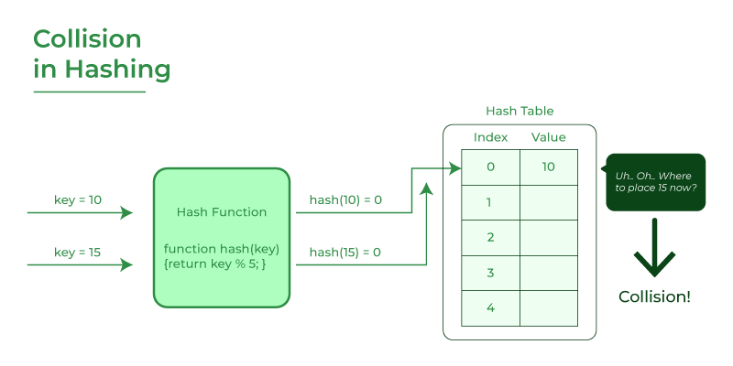
What is Collision?

Slide 26
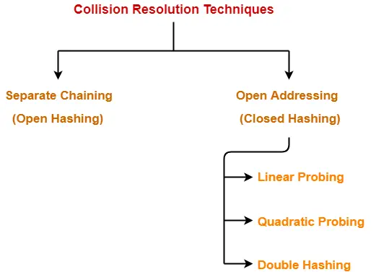
7. Methods of resolving the collisions and with examples

Slide 27
7.1. Separate chaining (Open Hashing):
This method involves making a linked list out of the slot where the collision happened, then adding the new key to the linked list.
Separate chaining is the term used to describe how the connected list of slots resembles a chain. It is more frequently utilized when we are unsure of the number of keys to add or remove.
Time complexity :
Its worst-case complexity for searching is o(n).
Its worst-case complexity for deletion is o(n).

Slide 28
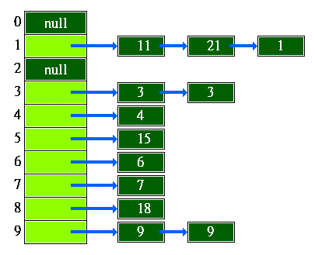
Example on separate Chaining - In this technique if two keys maps to a same hash value the elements are chained together as shown in the following figure

Slide 29
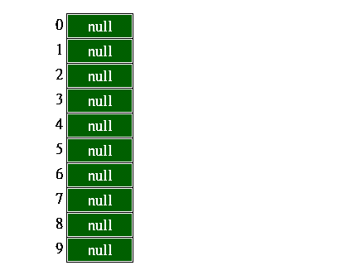
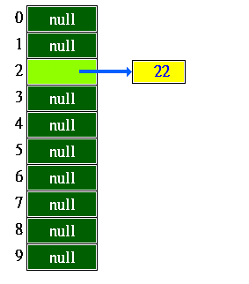
Example on Separate chaining
Perform the insertion operation with respect to the following four keys 22, 84, 35, 62 into a hash table of size 10 using separate chaining.
The hash function is key % 10
After insertion of 22
↓
Step-1 : Insertion of 22
index = 22 mod 10 = 2
Initial Hash Table -→

Slide 30
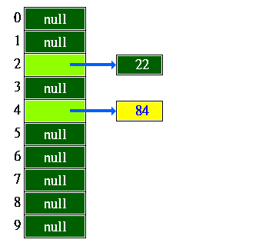
After inserion of 84
↓
Step-2 : Insertion of an item 84
index = 84 mod 10 = 4

Slide 31
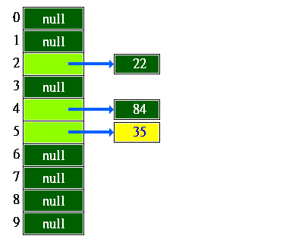
After inserion of 35
↓
Step-3 : Insertion of an item 35
index = 35 mod 10 = 5

Slide 32
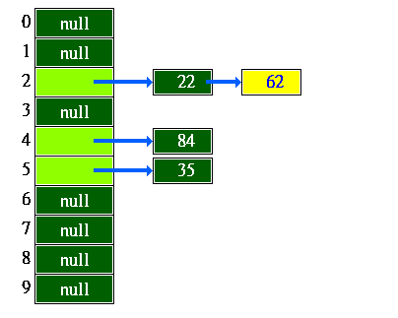
After inserion of 62
↓
Step-4 : Insertion of an item 62
index = 62 mod 10 = 2

Slide 33
Advantages of separate chaining
It is easy to implement.
The hash table never fills full, so we can add more elements to the chain.
It is less sensitive to the function of the hashing.
Disadvantages of separate chaining
In this, the cache performance of chaining is not good.
Memory wastage is too much in this method.
It requires more space for element links.

Slide 34
7.2. Open addressing (closed hashing.):
To prevent collisions in the hashing table open, addressing is employed as a collision-resolution technique.
The following techniques are used in open addressing: 1. Linear probing 2. Quadratic probing 3. Double hashing

Slide 35
7.2.1. Linear Probing :
In linear probing, if a collision occurs and a slot is already occupied, the algorithm linearly searches for the next available slot in a sequential manner. It checks the next slot and continues checking subsequent slots until it finds an empty slot.
The general formula for linear probing:
H(key,i)=(Hash(key)+i) mod TableSize
Note: Linear probing may cause primary clustering. Primary clustering refers to a phenomenon in closed hashing where consecutive collisions form long chains of occupied slots, leading to the accumulation of elements in specific regions of the hash table.

Slide 36
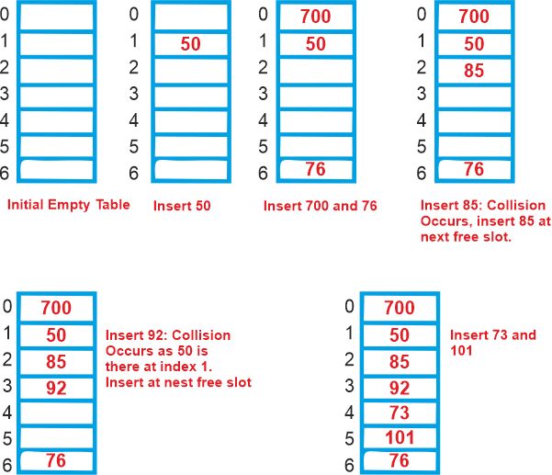
Example : Let's use "key mod 7" as a simple hash function with the following keys: 50, 700, 76, 85, 92, 73, 101.
probing is a process of finding another free location in the hash table for the element when a collision occurs.

Slide 37
Advantages and Disadvantages of Linear Probing
Linear probes have two advantages:
They are quite simple to implement.
Data tend to remain near their home address.
Disadvantages:
Linear probes tend to produce primary clustering(data clustered around home address). In otherwords the Primary clustering is a phenomena where many successive items form clusters i.e. consecutive elements form groups , making it difficult to locate a free slot or to search for an element in the hash table.
They tend to make the search algorithm more complex, especially after data have been deleted.

Slide 38
C-Code for Linear Probing
void Insertion(int item)
{
int index = hashing_moduloDivision(item);
// collision resolution by linear probing
while (hashTable[index] != -1) {
index = (index + 1) % TABLE_SIZE;
}
hashTable[index] = item;
}

Slide 39
7.2.2. Quadratic Probing:
In quadratic probing, instead of probing the next slot linearly, the algorithm uses a quadratic function to determine the next probe position. The probing sequence follows a quadratic pattern until an empty slot is found. i.e hash(x)=(hash(x) + i² ) % S, Where i is the current iterartion where collision has to be resolved.
The general formula for quadratic probing: let hash(x) be the slot index computed using hash function.
If slot hash(x) % S is full, then we try (hash(x) + 1*1) % S
If (hash(x) + 1*1) % S is also full, then we try (hash(x) + 2*2) % S
If (hash(x) + 2*2) % S is also full, then we try (hash(x) + 3*3) % S Note: Quadratic probing may cause secondary clustering. Secondary clustering is another form of clustering in closed hashing that occurs when different keys produce the same probe sequence, leading to repeated patterns of collisions.

Slide 40
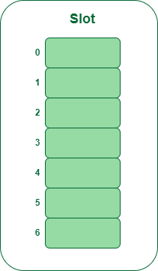
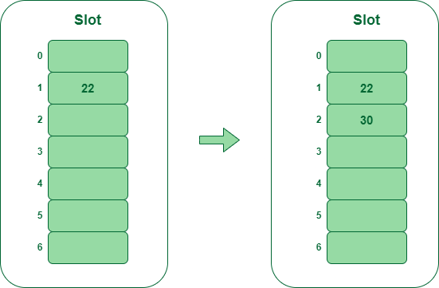
Example: Let us consider table Size = 7, hash function as Hash(x) = x % 7 and collision resolution strategy to be f(i) = i^{2,} where i is the iteration .
Insert = 22, 30, and 50.
Step 1: Create a table of size 7
Step 2 : Insert 22 and 30
Hash(22) = 22 % 7 = 1, Since the cell at index 1 is empty, we can easily insert 22 at slot 1.
Hash(30) = 30 % 7 = 2, Since the cell at index 2 is empty, we can easily insert 30 at slot 2.

Slide 41
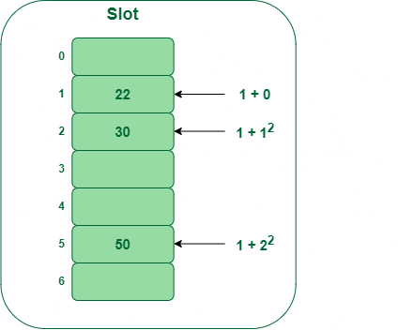
Step 3: Inserting 50
Hash(50) = 50 % 7 = 1
In our hash table slot 1 is already occupied. So, we will search for slot 1+1², i.e. 1+1 = 2,
Again slot 2 is found occupied, so we will search for cell 1+2², i.e.1+4 = 5,
Now, cell 5 is not occupied so we will place 50 in slot 5.

Slide 42
C-Code for quadratic Probing
void Insertion(int item)
{
int index = hashing_moduloDivision(item);
// collision resolution by quadratic probing
int i=0;
int old_index=index;
while (hashTable[index] != -1) {
i++;
index = (old_index + i*i) % TABLE_SIZE;
}
hashTable[index] = item;
}

Slide 43
7.2.3. Double hashing:
In this, we employ a different hashing algorithm, and in the ith iteration, we look for (hash(x) + i * hash 2(x)) % S.
The determination of two hash functions requires more time. Although there is no clustering issue, the performance of the cache is relatively poor when using double probing.
let hash(x) be the slot index computed using hash function.
If slot hash(x) % S is full, then we try (hash(x) + 1*hash2(x)) % S
If (hash(x) + 1*hash2(x)) % S is also full, then we try (hash(x) + 2*hash2(x)) % S
If (hash(x) + 2*hash2(x)) % S is also full, then we try (hash(x) + 3*hash2(x)) % S

Slide 44
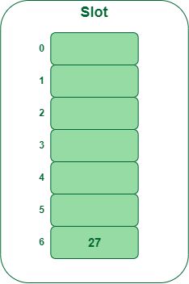
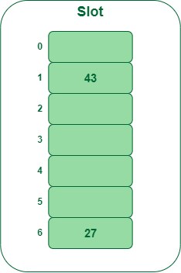
Example: Insert the keys 27, 43, 692, 72 into the Hash Table of size 7.
where first hash-function is h1​(k) = k mod 7 and second hash-function is h2(k) = 1 + (k mod 5)
Step 1: Insert 27, 27 % 7 = 6, location 6 is
empty so insert 27 into 6 slot.
Step 2: Insert 43
43 % 7 = 1, location 1 is empty
so insert 43 into 1 slot

Slide 45
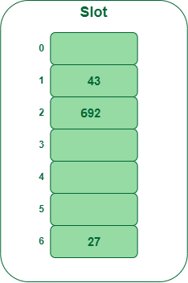
Step 3: Insert 692
692 % 7 = 6, but location 6 is already being occupied and this is a collision. So we need to resolve this collision using double hashing.
hnew = [h1(692) + i * (h2(692)] % 7
= [6 + 1 * (1 + 692 % 5)] % 7 { i=1, k=692 & h2(k) = 1 + (k mod 5) }
= 9% 7
= 2
Now, as 2 is an empty slot, so we can insert 692 into 2nd slot.

Slide 46
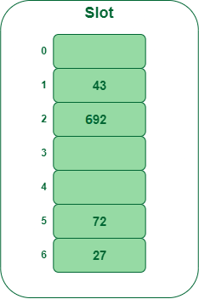
Step 4: Insert 72
72 % 7 = 2, but location 2 is already being occupied and this is a collision.
So we need to resolve this collision using double hashing.
hnew = [h1(72) + i * (h2(72)] % 7
= [2 + 1 * (1 + 72 % 5)] % 7 { i=1, k=72 & h2(k) = 1 + (k mod 5) }
= 5 % 7
= 5,
Now, as 5 is an empty slot, so we can insert 72 into 5th slot.

Slide 47
Exersize on double hashing
Show the hash table contents at every step of insertion operation with respect to the following keys 50, 700, 76, 85, 92, 73, 101.22, 84, 35 62. into the hash table of size - 11. Use double hashing to resolve the collision. Assume the following two functions :
First hash function as - hash_one(key) = key mod 11 and
Second hash function as - hash_two(key) = 1 + key mod 9

Slide 48
8. Comparision of Collision Resolution Techniques
S.N o | Separate Chaining | Open Addressing
1 | Chaining is Simpler to implement | Open Addressing requires more computation.
2. | In chaining, Hash table never fills up, we can always add more elements to chain. | In open addressing, table may become full.
3 | Chaining is Less sensitive to the hash function or load factors | Open addressing requires extra care to avoid clustering and load factor.
4 | Chaining is mostly used when it is unknown how many and how frequently keys may be inserted or deleted. | Open addressing is used when the frequency and number of keys is known.
5 | Cache performance of chaining is not good as keys are stored using linked list. | Open addressing provides better cache performance as everything is stored in the same table.
6 | Wastage of Space (Some Parts of hash table in chaining are never used). | In Open addressing, a slot can be used even if an input doesn’t map to it.
7 | Chaining uses extra space for links. | No links in Open addressing

Slide 49
9. Comparison of collision resolution by Open Addressing stretegies
Open addressing is a collision handling technique used in hashing where, when a collision occurs (i.e., when two or more keys map to the same slot), the algorithm looks for another empty slot in the hash table to store the collided key.

Slide 50
Linear Probing | Quadratic Probing | Double hashing
In linear probing, the algorithm simply looks for the next available slot in the hash table and places the collided key there. If that slot is also occupied, the algorithm continues searching for the next available slot until an empty slot is found. This process is repeated until all collided keys have been stored. Linear probing has the best cache performance but suffers from primary clustering. One more advantage of Linear probing is easy to compute. | In quadratic probing, the algorithm searches for slots in a more spaced-out manner. When a collision occurs, the algorithm looks for the next slot using an equation that involves the original hash value and a quadratic function. If that slot is also occupied, the algorithm increments the value of the quadratic function and tries again. This process is repeated until an empty slot is found. Quadratic probing has better performamnce in terms of cache and suffers from secondary clustering. | In double hashing, the algorithm uses a second hash function to determine the next slot to check when a collision occurs. The algorithm calculates a hash value using the original hash function, then uses the second hash function to calculate an offset. The algorithm then checks the slot that is the sum of the original hash value and the offset. If that slot is occupied, the algorithm increments the offset and tries again. This process is repeated until an empty slot is found. Double hashing has poor cache performance but no clustering. Double hashing requires more computation time as two hash functions need to be computed.

Slide 51
10. Advantages of Hashing in Data Structures
1. Key-value support: Hashing is ideal for implementing key-value
data structures.
2. Fast data retrieval: Hashing allows for quick access to elements
with constant-time complexity.
3. Efficiency: Insertion, deletion, and searching operations are highly
efficient.
4. Memory usage reduction: Hashing requires less memory as it
allocates a fixed space for storing elements.
5. Scalability: Hashing performs well with large data sets,
maintaining constant access time.
6. Security and encryption: Hashing is essential for secure data
storage and integrity verification.

Slide 52
END of UNIT-V

